Slide 2
Module 9

Slide 3
Before we start
Make sure that you are sitting correctly.
Turn on the lights.
Get ready with your Student’s Books, notebooks and pens.

Slide 4
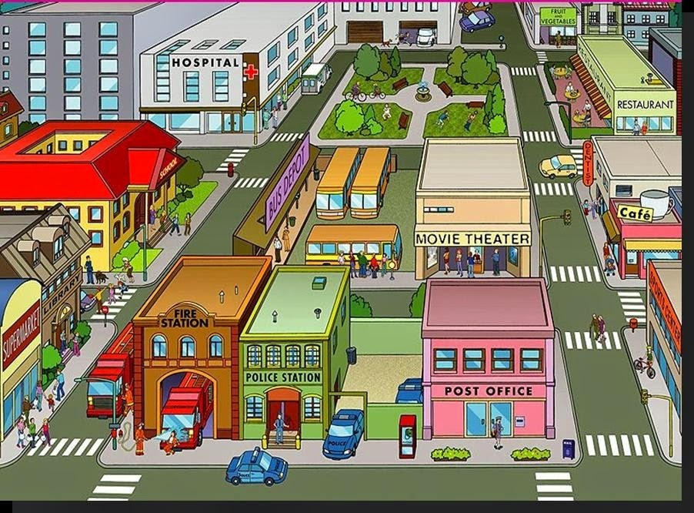
What can you see in the pictures? What are we going to discuss today?

Slide 5
We are going to discuss:
Shops
Prepositions of place
How to ask and give
directions in the street

Slide 6
Repeat the words after me:
Bakery Florist’s Café Shoe shop Newsagent’s Greengrocer’s Toy shop | Book shop Chemist’s Record shop Fast food restaurant Clothes shop Jeweller’s

Slide 7
Prepositions of place
up/down
to the left/right of…
on my left/right
on the corner of
next to
near
opposite
between

Slide 8
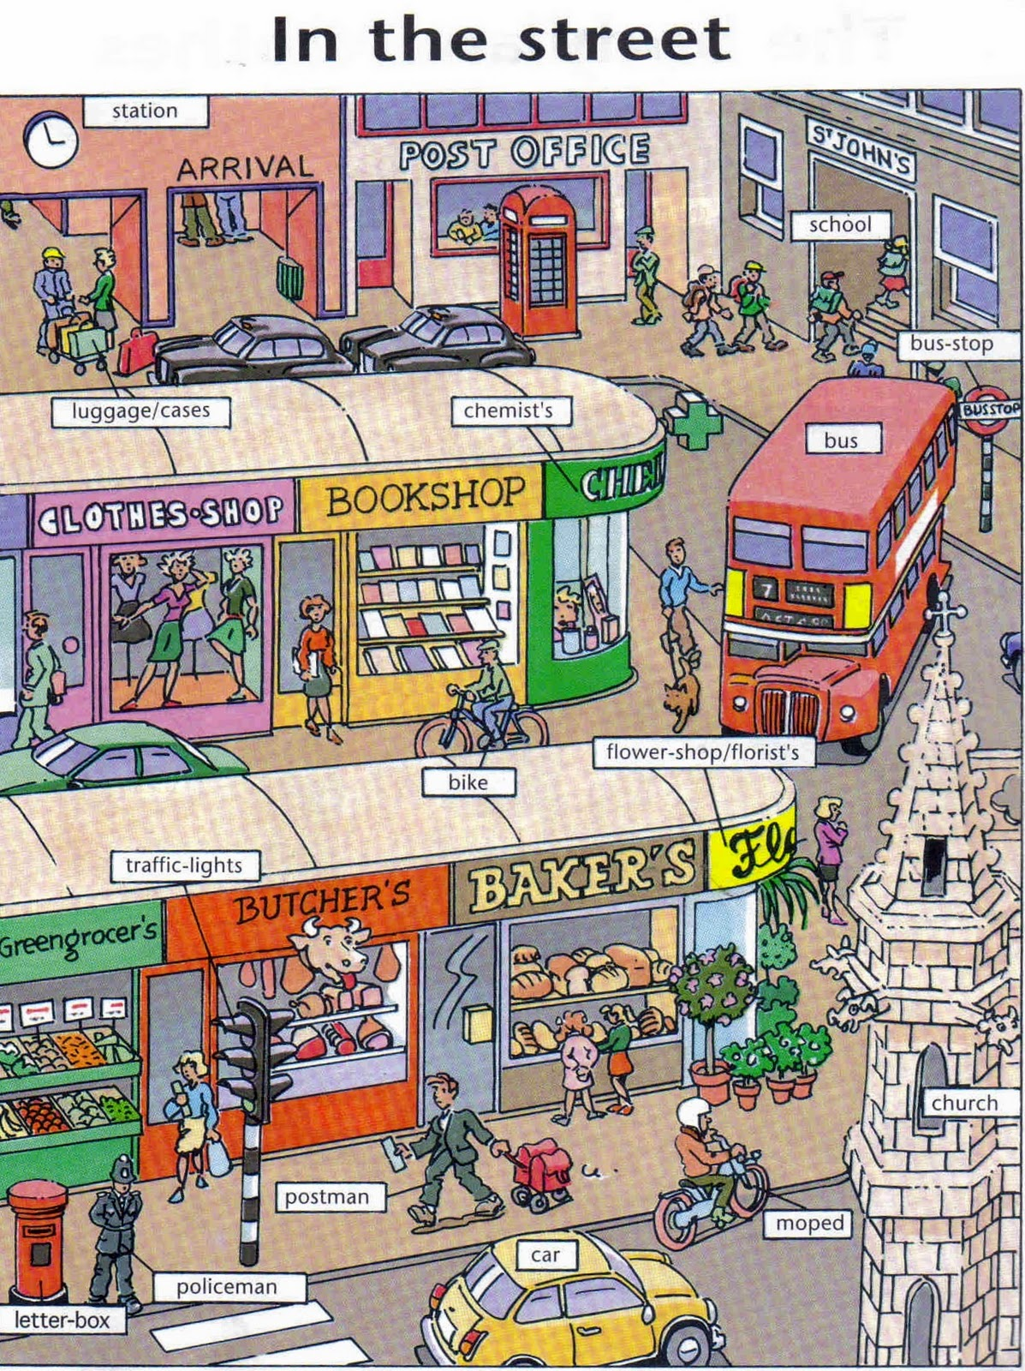
Finish my sentences:
We can buy warm gloves at the …. It’s next to the …

Slide 9
I can buy some roses at ……. It’s on the … of the street.

Slide 10
I can buy pizza at the … . It’s between the… and the …

Slide 11
I can buy some envelopes at the … It’s opposite the …

Slide 12
I can buy some fruit and vegetables at the… It’s near the …

Slide 13
SB: p. 112, ex. 1 Let’s listen to some phrases
Think how can you say them in Russian
What are these phrases for?
How can these phrases help you?

Slide 14
Ex.2
Let’s look at the map.
Listen to the dialogues.
Let’s read and find the places on the map.
What places people want to go?

Slide 15
Look at the map. Add the prepositions: between, on the corner, opposite, next to
1) The toy shop is_______ the clothes shop and the fast food restaurant.
2) The newsagent's is________ of Alma street and Eldon Road.
3) The book shop is_______ the clothes shop.
4) The fast food restaurant is_________ the toy shop.

Slide 16
Hometask:
1) Учебник: с. 112, №3 – выбрать направление движения и составить свой диалог, используя фразы ниже из оранжевой рамочки и образец диалогов в №2.
2) Рабочая тетрадь: с. 69, № 1,4,5, с. 70, №9 (предложения: 2, 3, 5, 7), №10 (3)
Выслать: записанный диалог, №9, 10 из рабочей тетради.

